Slide 1

Metadata Infrastructure
caGrid / Novartis Workshop
Rockville, MD
June 22nd-26th , 2009

Slide 2
Agenda
Model Driven Architecture
Metadata Registries
Metadata on the Grid
GME
Syntax / Semantics Binding
caGrid Metadata
MMS
Advertisement and Discovery
Example

Slide 3
Interoperability
The ability of multiple systems to exchange information and to be able to use the information that has been exchanged.
Semantic interoperability
Syntactic interoperability

Slide 4
Why Model?
Modeling achieves four aims:
Helps you visualize a system
Permits you to specify the structure or behavior of a system
Guides you in constructing a system
Documents the decisions you have made
Build models of complex systems because they are difficult to comprehend in their entirety
Build models to better understand the system you are developing.
The caBIG™ process and architecture is model driven, it is required for interoperability and silver level compliance.
Notes:
Why model?
Short answer is it is absolutely required and the first step in the caCORE process is to draw your system/project domain in UML. * The model, when semantically annotated and combined with service metadata becomes the foundation that allows the grid and grid services to programmatically discover and combine relevant information from different data services. This has to be done early and well and updated as you update your data service
Remember the model is not just for your application but for interoperability with others.
In addition is helps by
Helps you visualize a system
Permits you to specify the structure or behavior of a system
Guides you in constructing a system
Documents the decisions you have made
Additional reasons are:
Build models of complex systems because they are difficult to comprehend in their entirety
Build models to better understand the system you are developing.
The caBIG process and architecture is model driven, it is required for interoperability and silver level compliance
There are three parts to the system model: the logical model, data model, and data mapping model. The logical model describes the target domain and should be created in the logical package.* The Data Model describes the database schema* and the Object relational mapping maps classes to object. All of these are drawn in UML. Throughout this presentation, the terms “logical model”, “domain model” and “object model” are used interchangeably.*
caCORE SDK tools impose modeling guidelines* such as
Java naming conventions*
Package rules*
Element constraints*
For Example, *
*Only UML class diagram elements may be used
*Cannot use interface, object, etc.
Detailed instructions on creating diagrams in UML can be found in the SDK Programmer’s Guide.

Slide 5
What is UML?
UML is a language for
Visualizing
Specifying
Constructing
Documenting
The artifacts of a software system.
UML allows you to build models that are precise, unambiguous and complete
There are many UML diagram types
caBIG tools utilizes one type, the UML Class Diagram
Notes:
Visualizing: Communicating conceptual models to others is prone to error unless everyone involved speaks the same language. There are things about a software system you can’t understand unless you build models. An explicit model facilitates communication.
Specifying: UML allows you to build models that are precise, unambiguous and complete. There are many UML diagram types. caCORE utilizes one diagram type: UML Class Diagram
Constructing: UML models can be directly connected to a variety of programming languages. Maps to Java, C++, Visual Basic, etc. Tables in a RDBMS or persistent store in an OODBMS Permits forward engineering Permits reverse engineering
Documenting: The UML addresses documentation of system architecture, requirements, tests, project planning, and release management.
There are many UML diagram types, however caCORE utilizes one diagram type – the UML Class Diagram
Throughout this presentation we only talk about the logical model the most critical one to get right for caBIG , the terms “logical model”, “domain model” and “object model” are used interchangeably.*

Slide 6
UML Documenting
UML can be used to document of system architecture, requirements, tests, project planning, and release management.
caBIG requires only class diagrams for a logical model.
Use Case Diagram
Deployment Diagram
- À©µµ¿ì 95 : Å¬¶óÀÌ¾ðÆ®
ºÐ»ê È¯°æÀÇ ÇÏµå¿þ¾î¹× ³×Æ®¿÷À¸·ÎÀÇ Á¤º¸ ½Ã½ºÅÛ ¿¬°á ¸ðµ¨
- À©µµ¿ì NT: ÀÀ¿ë¼­¹ö
- À¯´Ð½º ¸Ó½Å: ÀÀ¿ë ¼­¹ö ¹× µ¥ÀÌÅ¸ ¼­¹ö, Åë½Å ¼­¹ö
- IBM ¸ÞÀÎÇÁ·¹ÀÓ: µ¥ÀÌÅ¸ ¼­¹ö, Åë½Å ¼­¹ö
Use Case 1
Window95
Windows95
Windows95
¹®¼­°ü¸®
Å¬¶óÀÌ¾ðÆ®.EXE
Windows
¹®¼­°ü¸® ¾ÖÇÃ¸´
Actor A
Use Case 2
Actor B
NT
Solaris
¹®¼­°ü¸® ¿£Áø.EXE
Alpha
Windows
ÀÀ¿ë¼­¹ö.EXE
UNIX
Use Case 3
NT
IBM
Mainframe
µ¥ÀÌÅ¸º£ÀÌ½º¼­¹ö
mainWnd
fileMgr :
document :
gFile
repository
FileMgr
DocumentList
Document
user
FileMgr
Document
add( )
name : int
fetchDoc( )
delete( )
docid : int
Æ¯Á¤¹®¼­¿¡ ´ëÇÑ º¸±â¸¦
1: Doc view request ( )
sortByName( )
get( )
numField : int
read() fill the
»ç¿ëÀÚ°¡ ¿äÃ»ÇÑ´Ù.
open( )
code..
2: fetchDoc( )
close( )
FileList
fList
read( )
sortFileList( )
3: create ( )
add( )
create( )
fillDocument( )
delete( )
1
4: create ( )
5: readDoc ( )
1
È­ÀÏ°ü¸®ÀÚ´Â ÀÐ¾î¿Â
6: fillDocument ( )
¹®¼­ÀÇ Á¤º¸¸¦ ÇØ´ç ¹®¼­
°´Ã¼¿¡ ¼³Á¤À» ¿äÃ»ÇÑ´Ù.
7: readFile ( )
Repository
rep
File
È­¸é °´Ã¼´Â ÀÐ¾îµéÀÎ
8: fillFile ( )
(from Persistence)
read( )
GrpFile
°´Ã¼µé¿¡ ´ëÇØ ÀÌ¸§º°·Î
9: sortByName ( )
name : char * = 0
º¸¿©ÁØ´Ù.
Á¤·ÄÀ» ½ÃÄÑ È­¸é¿¡
readDoc( )
read( )
readFile( )
open( )
create( )
fillFile( )
Sequence Diagram
Class Diagram
Notes:
UML addresses documentation of system architecture, requirements, tests, project planning, and release management.
Example UML diagrams include:
Use Case Diagrams
Deployment Diagrams
Sequence Diagrams
Class Diagrams
As stated before, caCORE utilizes only the class diagrams which will be the focus of our training today.

Slide 7
How are caBIG™ models different?
caBIG™ services are expected to have a domain information model:
A Domain Information Model is a representation of our understanding of an area of knowledge
A Domain Information Model consists of ‘Classes’ that represent ‘things’ in the real world
In a Domain Information Model, classes contain ‘attributes’ that are characteristics of different instances of things in the real world

Slide 8
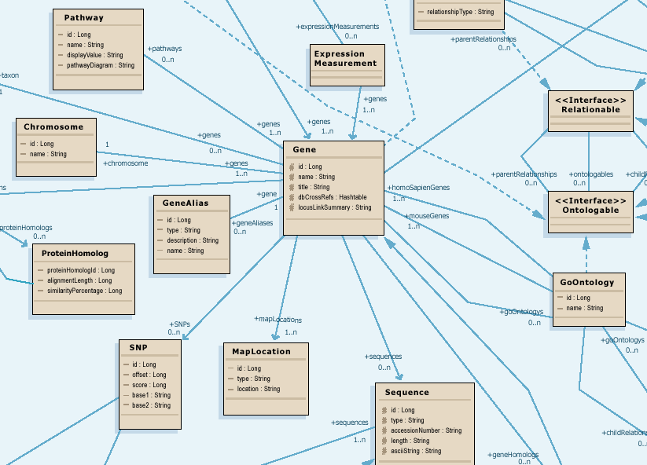
Modeling for Interoperability
Class diagram models target domain
Logical model is basis for semantic integration
Focus on attributes and relationships of domain objects

Slide 9
Data Model Meaning
What do all those data classes and attributes actually mean, anyway?
Data descriptors or “semantic metadata” required
Computable, commonly structured, reusable units of metadata are “Common Data Elements” or CDEs

Slide 10
Cancer Data Standards Repository (caDSR)
UML Class | caDSR Data Element
Class | Object Class
Attribute | Property
Datatype (of the attribute) | Value Domain
data element
concept
representation
term
ISO/IEC 11179 compliant Data Element Concepts
Cancer Data Standards Repository (caDSR) is the database and tools used to house the metadata from caBIG® UML models
UML Class Diagrams form the basis for creating and registering semantically unambiguous caDSR metadata
In the caDSR, a data element corresponds to the combination of a semantically annotated class attribute
Notes:
10
caBIG relies on the metadata housed in caDSR for interoperability.
The class/attribute combination forms the Data Element Concept. The class attribute datatype is represented as a Value Domain.

Slide 11

Cancer Data Standards Repository (caDSR)
UML Class
caDSR Data Element
Gene
Gene Name java.lang.String
- name: String
Gene Name
Gene
Name
java.lang.String
= concept annotations
string
ISO/IEC 11179 compliant Data Element
Notes:
11
The ISO 11179 metamodel provides a very rich metadata model to use for semantic integration and semantic surfing later on

Slide 12
Details of a Concept
Name
Code (Concept Unique Identifier)
Properties
Definition (s)
Synonym (s)
Preferred name: the term recommended for use in written and oral communication
Links to use or related information in other, external resources, such as UMLS
Roles
Relationships with other concepts
Taxonomy / Hierarchy
Superconcepts / More General Concepts / Parents
Subconcepts / More Specific Concepts / Children

Slide 13

Enterprise Vocabulary Services (EVS)
Controlled vocabulary resources for cancer research community
Manages the concepts
NCI Thesaurus
NCI reference terminology (public domain, open source)
46,000 concepts covering agents, anatomy, biological processes, diseases, genes, gene products, and techniques/equipment
Built using description logic
Designed for application development: database coding, searching, and data mining
NCI Metathesaurus
Online dictionary and thesaurus
Adaptation of National Library of Medicine’s Unified Medical Language System (UMLS) Metathesaurus
930,000+ concepts; 2,200,000 terms and phrases
Built using lexical matching
Designed for term mapping and document indexing across vocabularies

Slide 14
What can EVS do?
Check and compare dictionary definitions
Find synonyms
Determine relationships to other concepts/terms
Identify and evaluate potential options when curating new CDEs or adding terms to permissible value lists
Provide links to related research publications

Slide 15
Why do you need semantic metadata?
<Agent>
<name>Taxol</name>
<nSCNumber>007</nSCNumber>
</Agent>
Class/ Attribute | Example Object Data | CIA Metadata | NCI Metadata
Agent |  | A sworn intelligence agent; a spy | Chemical compound administered to a human being to treat a disease or condition, or prevent the onset of a disease or condition
Agent.nSCNumber | 007 | Identifier given to an intelligence agent by the National Security Council | Identifier given to chemical compound by the US Food and Drug Administration Nomenclature Standards Committee
Agent.name | Taxol | CIA code name given to intelligence agents | Common name of chemical compound used as an agent

Slide 16
Computable Interoperability
Agent
C1708
Drug
C1708
name
id
nSCNumber
C1708:C41243
NDCCode
CTEPName
approvalDate
FDAIndID
approver
IUPACName
fdaCode
C1708:C41243
My model
Your model

Slide 17
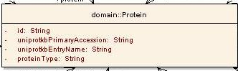
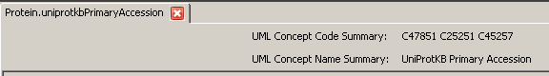
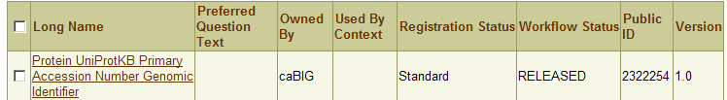
Modeling Metadata Review
UML Modeling
UML Class/attribute
EVS Concept Codes
Semantic Annotation using EVS concepts
CDE Public ID/version
CDE Long Name
caDSR Load/CDE Creation
Notes:
17
You will see in the afternoon and heard in Silver Level Compatibility
Every system needs to have a UML model descriptive enough
All the attributes and classes for this system is annotated using terms/concepts from Enterprise Vocabulary System
The information model is registered in cancer data standards reporsitory and transformed to common data elements.
For now consider each class/attribute/data type tuple corresponds to a CDE. Each CDE has a public ID.

Slide 18
So what does this mean to caGrid?
Support a strongly typed grid
Syntactic and Semantic interoperability
Programmatic!
Smooth transition from Application to Grid and back
Leverage wealth of existing metadata
Enable service Advertisement and Discovery

Slide 19
caGrid Data Description Infrastructure
Client and service APIs are object oriented, and operate over well-defined and curated data types
Objects are defined in UML and converted into ISO/IEC 11179 Administered Components, which are in turn registered in the Cancer Data Standards Repository (caDSR)
Object definitions draw from controlled terminology and vocabulary registered in the Enterprise Vocabulary Services (EVS), and their relationships are thus semantically described
XML serialization of objects adhere to XML schemas registered in the Global Model Exchange (GME)

Slide 20
Global Model Exchange
Acts as an authoritative XML Schema registry for the grid
Primary function is to ensure global referential integrity of all the XML Schemas used on the grid, and provide operations for their registration and discovery
Provides utility APIs for uploading from and downloading to a local file system, graphical interfaces, and integration into Introduce as a data type discovery mechanism

Slide 21
GME Theory : Why does the GME exist?
Definitions:
XML Schema X may have associations to other XML Schemas; in the context of XML Schema X those associated XML Schemas are defined as:
"dependency schemas": are those schemas which schema X imports/includes
"depending schemas": are those schemas which import/include schema X
A "locally sound" schema is one which:
is well formed and valid (with respect to schema schema, etc)
all its dependency schemas are locally sound
A "globally sound" schema is one which:
is locally sound
all its depending schemas are locally sound
The GME’s main purpose is to ensure all schemas used on the grid are “globally sound”
Can be complicated in the face of updates and deletions

Slide 22
caBIG/caGrid use of GME
While GME can handle any XML Schema, current practice is to only register XML Schema for “data objects” not entire message structures (e.g. WSDL parts)
Mirrors the Domain Information Model notion previously discussed
Focuses on extremely robust, semantically anchored data models, which can easily be used by many services for different purposes
I.e. each operation of a service can just reference these defined types and use them for multiple different behaviors
Example: Might be 50 different analytical operations for a given data set model
Rich discovery framework allows for such services/operations to be discovered

Slide 23
GME Uses
Current infrastructure use of GME is mostly at “development time”
Publish during data model registration
Discovery during service development
Runtime uses possible
Discovery of authoritative syntax for integration scenarios or workflows
Data instance syntax validation

Slide 24
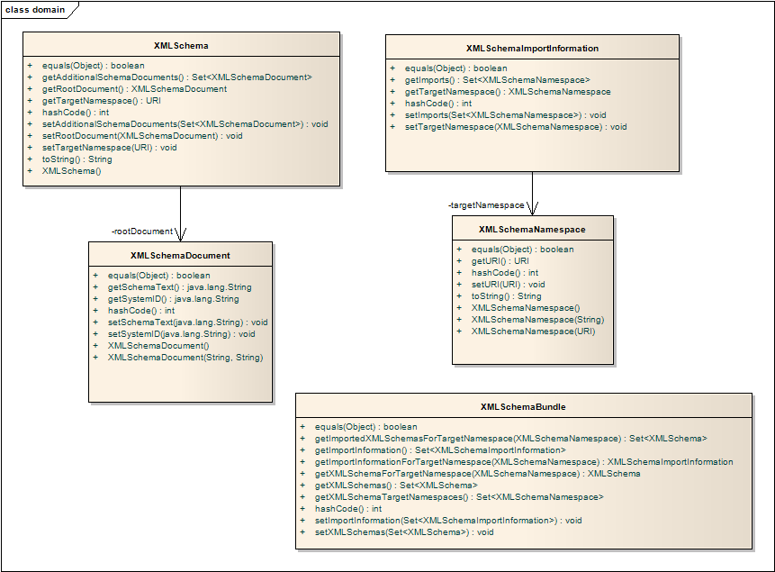
GME Information Model
An XML Schema :
is Identified by a namespace
is Comprised of 1 or more documents
Imports 0 or more other XML Schemas
This creates a network of schema relations, which can be retrieved via a Bundle

Slide 25
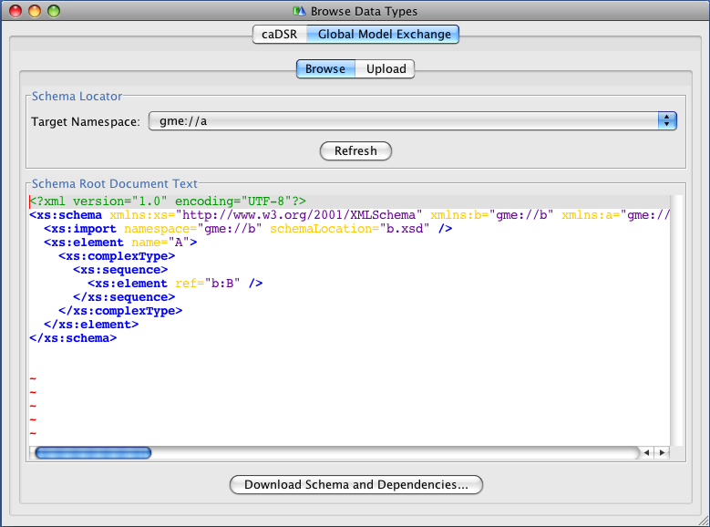
Introduce Integration: Browsing Schemas
Simple view of schemas directly from Introduce

Slide 26
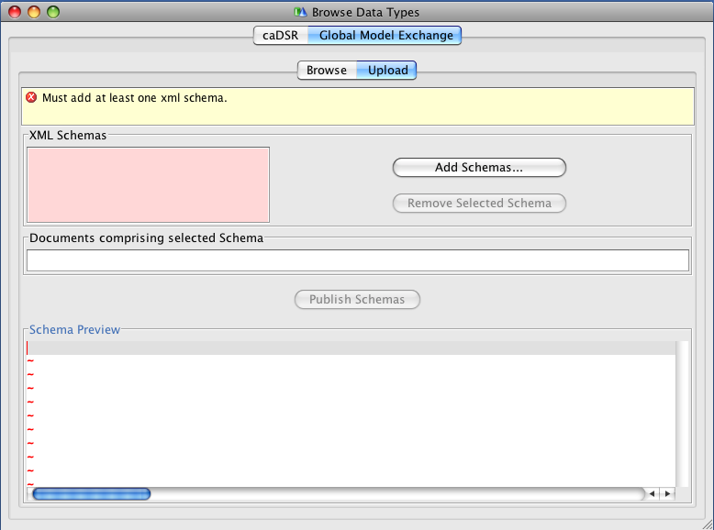
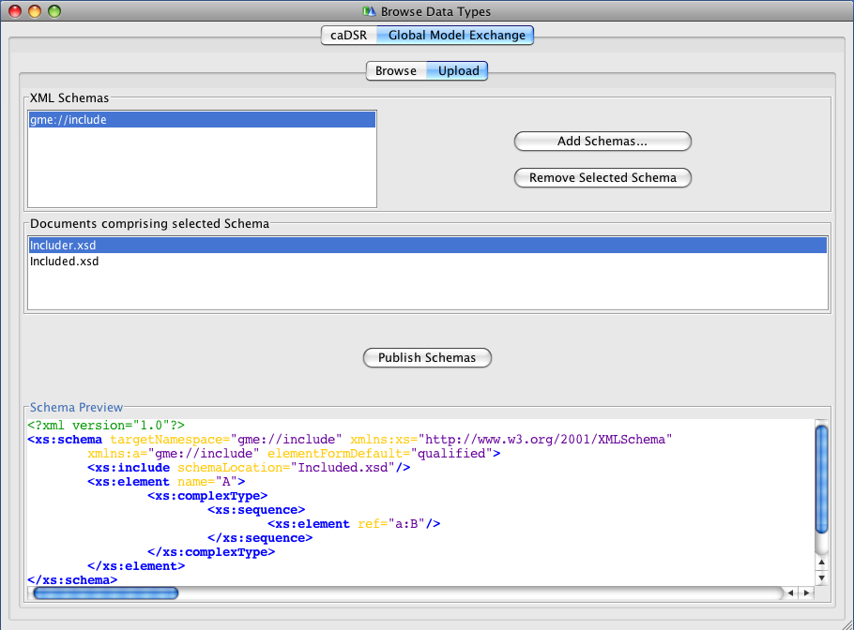
Introduce Integration: Publishing Schemas
Publish new models directly from Introduce
Supports loading multiple schemas from the file system
Graphical validation framework indicates any issues
Includes/redefines automatically recursively processed

Slide 27
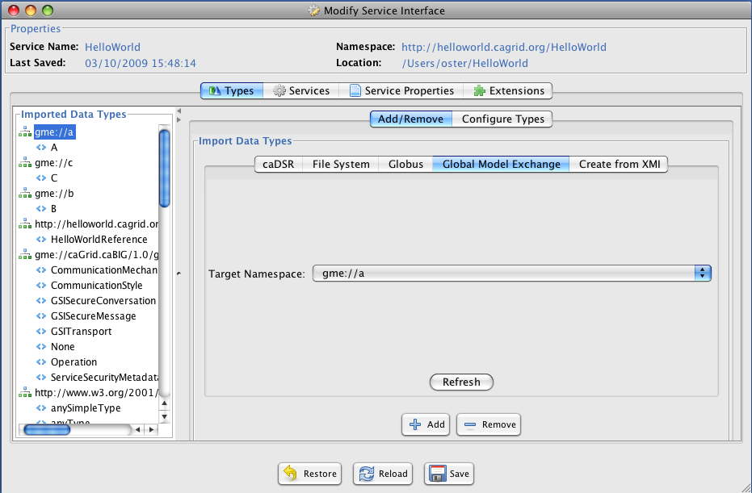
Introduce Integration: Leveraging models in service interfaces
Schemas and all their dependencies can automatically added to Introduce by Namespace (also indirectly via caDSR Project)

Slide 28
Syntax/Semantics Problem Statement
Achieving interoperability goals on the grid requires not only sound handling of both syntax and semantics, but also a formal binding between them
Previously, the binding was:
implicit and based upon overly constraining assumptions (in some cases)
difficult to make use of programmatically
difficult to verify, and therefore enforce, compliance with

Slide 29
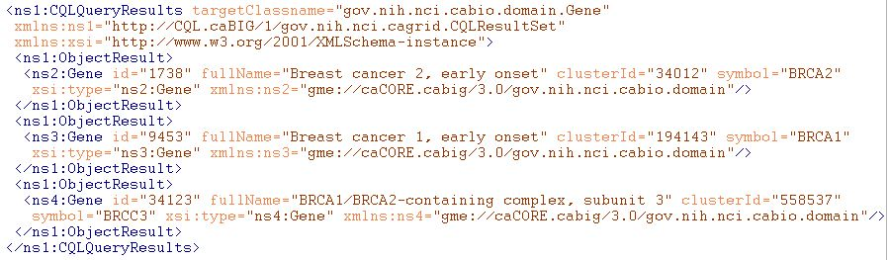
Example of Grid Data Syntax
XML of CQL Results from a query to a Data Service
Infrastructure capable of mapping directly back to corresponding programming language objects
Semantics of data are explicitly bound to the conceptual model (DomainModel) the user queried against, and implicitly associated with this XML via it’s namespace

Slide 30
Example Syntax Use Cases
I’m writing an application to process arbitrary data types, how do I know what the data will look like?
I want to build a grid service, how do I describe the inputs and outputs of its operations?
How can I be sure data I am getting is valid?
I don’t want to work with WSDL or XML, can’t I just use an object-oriented client API to talk to grid services?

Slide 31
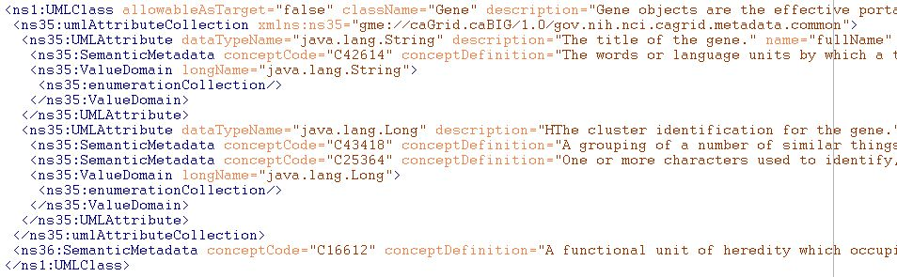
Example of Grid Data Semantics
Snippet of XML representation of DomainModel metadata from a Data Service
Describes the caDSR-registered logical structure, used to query the service; annotated with concept codes from EVS
Independent of the syntax used to realize the data types on the grid (such as in the results of a query)

Slide 32
Example Semantics Use Cases
What are the service addresses of all the running Data Services exposing data based on concept C16612?
What are the permissible values of Taxon.abbreviation in the caBIO 3.1 model?
Are there any Analytical Services on the grid which provide operations over a data type that is semantically interoperable with the caBIO 3.1 Tissue.organ?
How do I learn about the data available from an arbitrary Data Service?

Slide 33
Example Semantic/Syntax Binding Use cases
I’ve received a generic data set (such as a CQL results object), how can I understand the semantics of the contained data?
I want to describe a workflow using either logical models or EVS concepts, how can I figure out how the XML is structured such that I can use BPEL to extract data?
Better yet, is there a graphical tool that can do the transformation for me?
I registered my model in caDSR, why is Introduce asking me for XML Schemas?

Slide 34
Realizing the Binding Use Cases
Need the capability to formally describe, register, and access the association between a given data type’s syntax and semantics
The foundation of the grid data syntax is XML Schema; XML Schemas are identified by their namespaces
The foundation of the grid data semantics are the EVS annotated, caDSR data models; data models are identified by their caDSR identifier and version
The binding between syntax and semantics is essentially a mapping from the UML/caDSR universe to the XML/GME universe

Slide 35
Connecting UML and XML: Previous Implementation
Previous “solution” was to require an XML Schema for each package that followed a namespace construction rule
Had several limitations:
Several caBIG projects wish to reuse existing XML Schemas, which have existing namespaces (can’t be changed for interoperability reasons)
Some uniqueness constraints assumed are not strictly enforced
Does not support “reverse lookup” (XSD -> caDSR)
Does not provide fine grain mapping necessary for some applications/infrastructure
Somewhat prescriptive (namespaces, naming conventions, etc) when ideal solution is entirely descriptive

Slide 36
Connecting UML and XML: The complexities
There are a large variety of options on how a conceptual UML model can be represented in XML (many in use within caBIG as well as relevant external XML standards)
Assumptions on namespaces or structure don’t work
Most applications/services “don’t care,” so process must be simple for the default case, but sufficient for the others
Names different
Attribute or element?
What about Collection associations
?

Slide 37
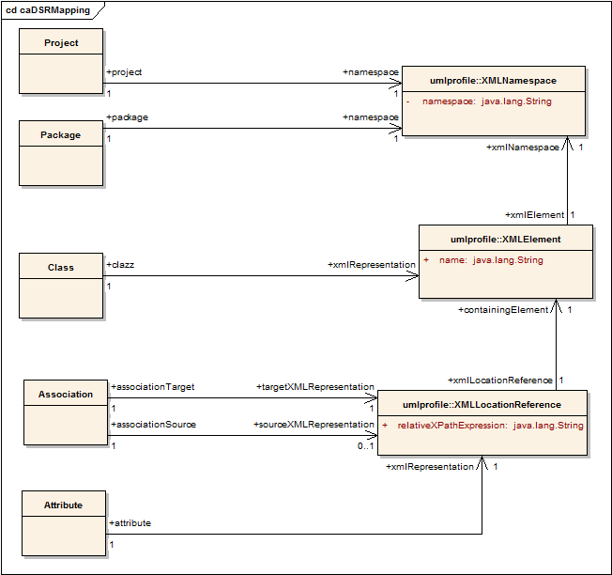
Connecting UML and XML: Conceptual solution
Definition of mapping rules specify how a given UML entity is represented in XML over the grid
Maintained in the caDSR, lookup and query available through caDSR grid service

Slide 38
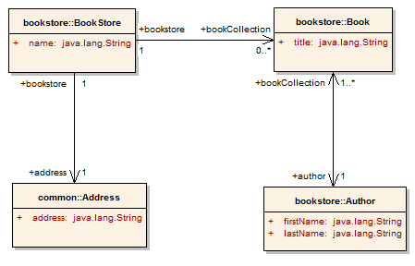
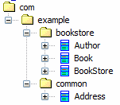
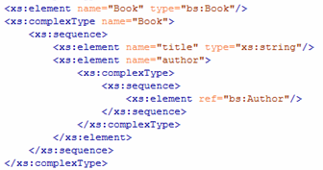
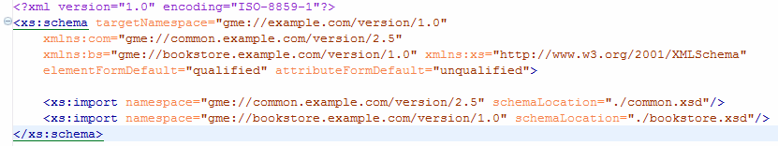
Partial Mapping Example
Project:
BookStore
Version:
1.0
Attribute Mapping
XPath:
title
Element:
Book
Namespace: gme://bookstore.example.com/version/1.0
Project’s Namespace (gme://example.com/version/1.0)

Slide 39
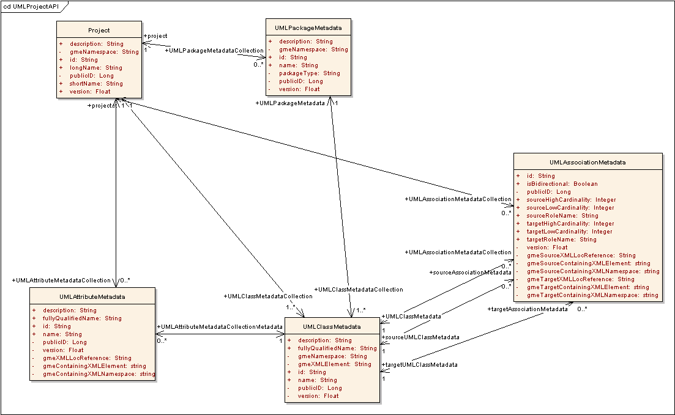
caDSR UML Project Mapping Realization

Slide 40
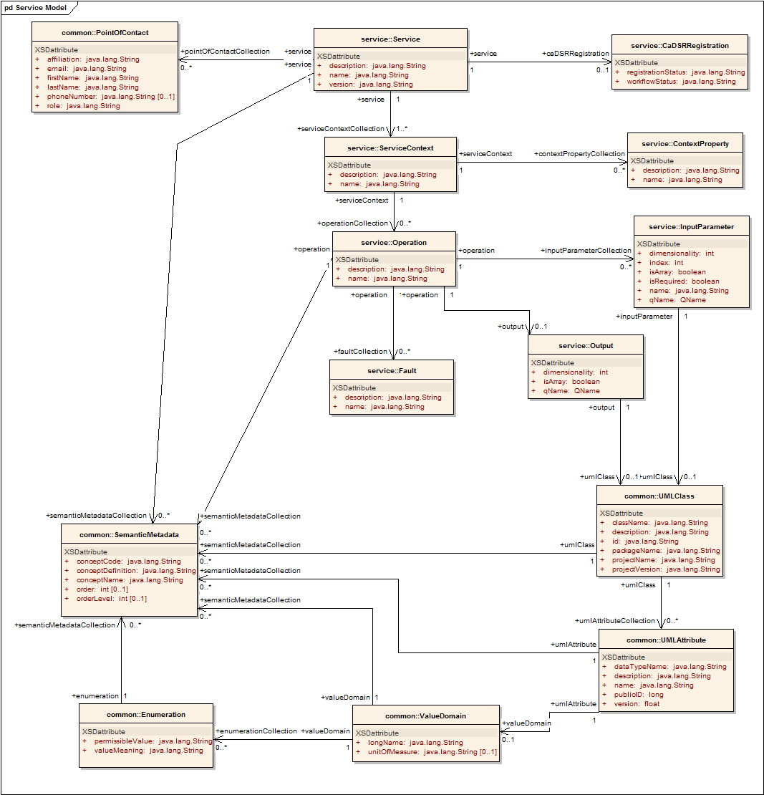
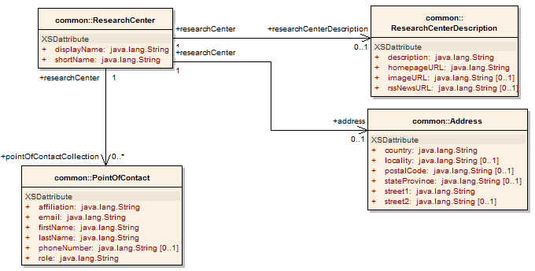
Service Metadata: Core Model
Common Service Metadata
Provided by all services
Details service’s capabilities, operations, contact information, hosting research center
Service operation’s inputs and outputs defined in terms of structure and semantics extracted from caDSR and EVS
Majority auto-generated by Introduce; annotated via MMS

Slide 41
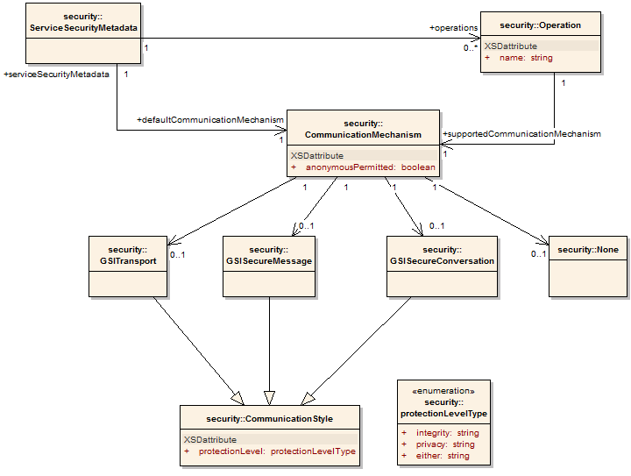
Service Metadata: Service Security
Service Security Metadata
Provided by all services
Details the service’s requirements on communication channel for each operation
Can be used by client to programmatically negotiate an acceptable means of communication
For example: Does operation X allow anonymous clients, or are credentials required?
Auto-generated by Introduce

Slide 42
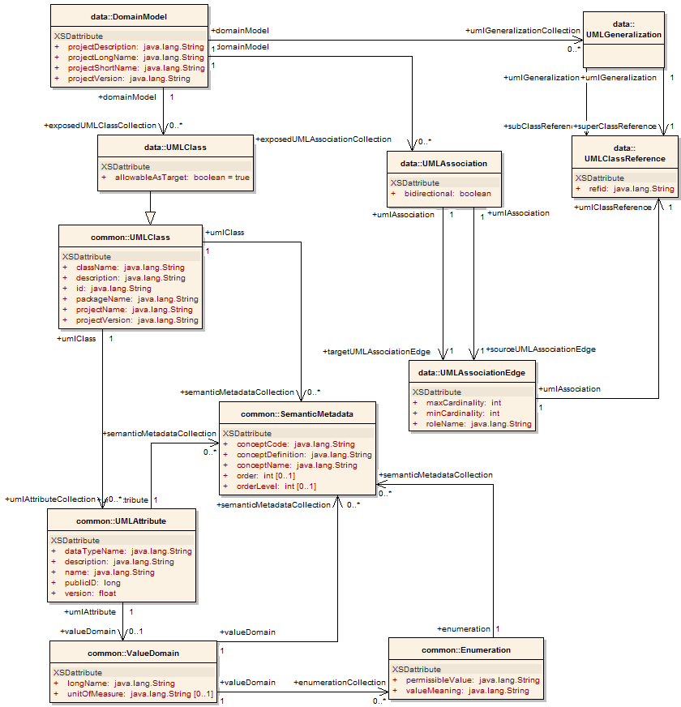
Service Metadata: Data Service
Data Service Metadata
Provided by all data services
Describes the Domain Model being exposed, in terms of a UML model linked to semantics
Provides information needed to formulate the Object-Oriented Query
As with common metadata, data types defined in terms of structure and semantics extracted from caDSR and EVS
Auto-generated by Introduce via MMS

Slide 43
Metadata Model Service (MMS)
MMS provides the ability to generate Domain Models and semantically annotate Service Metadata
Is a generic service which provides the ability to integrate any external metadata registry as a metadata source for annotations
Leverages Spring for deploy-time configuration
Default implementation uses the production caDSR as its source, but (multiple) other registries can be added to the same service
Not dependent on a particular model or software version of the caDSR
Makes full use of the new caDSR XML Schema namespace binding annotations
Fully integrated into Introduce for visualizing Domain Models and annotating metadata instances

Slide 44
MMS API
Generating Domain Model Metadata
Operations all take a UMLProjectIdentifier which specifies a target (or default) external registry, and the information that registery requires to identify a particular UML Model
generateDomainModelForProject
Uses the whole project
generateDomainModelForPackage
Uses a subset of packages of the specified project
generateDomainModelForClasses
Uses a subset of classes of the specified project
generateDomainModelForClassesWithExcludes
Uses a subset of classes of the specified project, while excluding some of their associations
Annotating Service Metadata
annotateServiceMetadata
Annotates an instance of ServiceMetadata by mapping the XML QNames of referenced data types to their semantic annotations in the appropriate external registry

Slide 45
MMS External Registries
As the MMS provides no "management" operations for the metadata models it expects its clients to reference, it is generally expected to be deployed referencing an external metadata registry
the default implementation is configured to make use of caBIG's Cancer Data Standards Repository (caDSR)
This external registry provides the means to add, modify, delete, or otherwise manage the UML models and their correspondence to XML Schemas which the MMS leverages
Each external metadata registry is expected to:
have a unique identifier
be able to uniquely identify UML projects within it via:
an identifier
an optional version
0 or more registry specific properties
Capabilities and requirements of external metadata registries a given MMS supports are exposed via ModelSourceMetadata service metadata

Slide 46
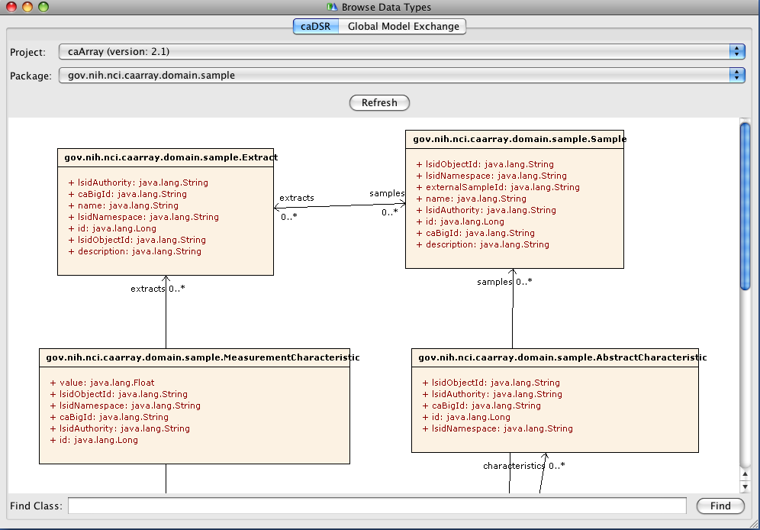
Introduce Integration: Domain Model Viewing
Allows graphical browsing of registered models from the caDSR

Slide 47
Introduce Integration: Metadata Annotation
Each time a user saves an Introduce service, a caGrid Metadata Introduce extension regenerates a ServiceMetadata instance by reading the Introduce model of the service
The extension then sends this instance to the MMS for semantic annotation, passing along any additional information (see next slide) present, to associate the data types with the correct source
The MMS adds all annotations it can, by consulting the appropriate external registries, and ignores the rest of the model
This annotated model is then saved for use when the service is deployed

Slide 48
Introduce Integration: Metadata Annotation, a caDSR example
The caDSR Data Type Discovery component of Introduce allows one to add models (XML Schemas) to their project, by browsing the caDSR and selecting a Project/Package
When such a model is added, the extension annotates the model with its caDSR information (e.g. Project name and version)
Later when the caGrid Metadata Introduce Extension uses the MMS to annotate the service's metadata, it reads this information and creates a series of NamespaceToProjectMappping which map each XML Schema's Namespace to the appropriate caDSR Project
The MMS then uses this information to ensure the correct metadata is associated with the operations which make use of types from those XML Schemas
As such, the NamespaceToProjectMappping array provides clients the ability to control the MMS behavior when there are multiple external metadata repositories supported and/or a given XML Schema Namespace ambiguously maps to multiple UML Models (i.e. multiple projects are reusing the same XML Schema)

Slide 49
Advertisement and Discovery Overview
Advertisement:
The caGrid Grid Service Owner composes service metadata describing the service to the grid and publishes it to grid. The service metadata describes properties of the grid services that caGrid users and other grid services may query.
Discovery:
A caGrid Researcher specifies search criteria describing a service. The research submits the discovery request to a discovery service, which identifies a list of services matching the criteria, and returns the list to the researcher.

Slide 50
Advertisement and Discovery Process
All services register their address and metadata information to an Index Service
The Index Service subscribes to the standardized metadata and aggregates their contents
Clients can discover services using a discovery API which facilitates inspection of data types
Leveraging semantic information in EVS (from which service metadata is drawn), services can be discovered by the semantics of their data types

Slide 51
Service Discovery Process
Clients formulate a query over the caGrid standard metadata
Examples:
“Find me all the services from Ohio State’s Cancer Center”
“Which Analytical services take Genes as input?”
“Which Data services expose data relating to lung cancer?”
“Find me all the services with some metadata mentioning the string ‘macromolecules’”
This query is sent to the caGrid Index Service which returns the Address(es) of the services satisfying the query
The client can then further interrogate the satisfying services by asking for all of their metadata or service descriptions
Finally the client invokes the desired services as appropriate

Slide 52
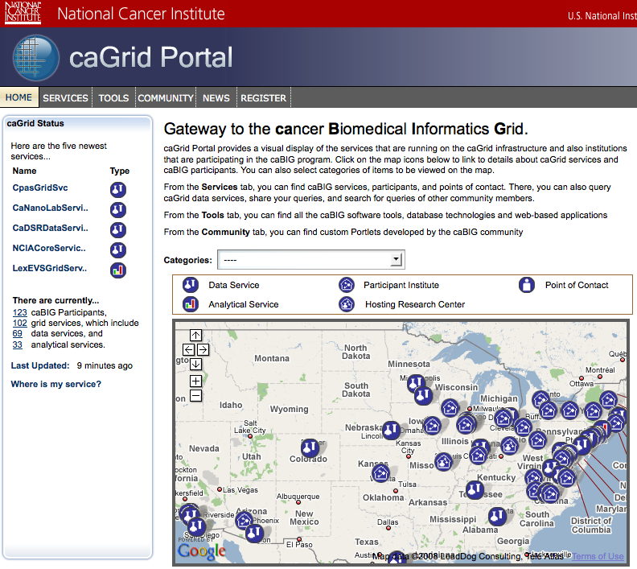
caGrid Portal: Service Map http://cagrid-portal.nci.nih.gov/
Google Maps integration enabled by Center Information in metadata
Recent services and categorization discovered from Index Service

Slide 53
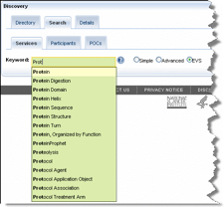
caGrid Portal: Metadata-driven Discovery
Structured discovery queries can be constructed over the metadata model
Keyword expansion with information from the controlled terminology available via the EVS

Slide 54
caGrid Portal: Service Details
Each discovered service’s metadata can be perused
Federated queries can be constructed graphically from auto-discovered potential semantic joins

Slide 55
Advertisement and Discovery Specifications view
Services’ Metadata is exposed as WSRF ResourceProperties of singleton Resource via standard RP interfaces
Registration to Index Service is performed via WS-ServiceGroup specification
Soft state registration and deregistration performed via WS-ResourceLifetime
Discovery from Index Service is performed via XPath profile of WSRF QueryResourceProperties

Slide 56
Discovery API Client – Example Methods
Searches based on service level metadata
E.g. discoverServicesByResearchCenter
Searches based on semantic annotation
E.g. discoverDataServicesByModelConceptCode
Searches based on operation metadata
E.g. discoverServicesByOperationName
Searches based on information model metadata (for data services)
E.g. discoverDataServicesByExposedClass
(internally used to implement all other methods) Searched based on XPath leveraging Service Metadata XML
discoverByFilter (String xpathPredicate)
Notes:
Examples give me all services hosted by Lombardi Comprehensive Cancer Center
Examples give me all services providing Gene information
Examples who is exposing a certain class

Slide 57
Discovery API Client – Discovering services using a keyword
//Index service on production caGrid
String serviceURL="http://cagrid-index.nci.nih.gov:8080/wsrf/services/DefaultIndexService";
// create a DiscoveryClient instance
DiscoveryClient client = new DiscoveryClient(serviceURL);
//discover services by keyword
EndpointReferenceType[] endPointReferenceArr = client.discoverServicesBySearchString(“Protein”);
//list URLs for returned services
for (int i=0; i < endPointReferenceArr.length; i++){
System.out.println("Address: "+endPointReferenceArr[i].getAddress());
}
Notes:
As any other service API client needs an instance needs to be created

Slide 58
Metadata API - MetadataUtils
Used to access and manipulate instances of service metadata
Complements the Discovery API;
Once a service is discovered MetadataUtils’s methods can be used to access and inspect the full metadata for the service

Slide 59
Metadata API – MetadataUtils Example Methods
Retrieves the service metadata or domain model from the specified service.
getServiceMetadata
getDomainModel
Writes/reads the XML representation of the service metadata to/from the specified writer/reader:
serializeServiceMetadata
deserializeServiceMetadata
Writes/reads the XML representation of the domain model to/from the specified writer/reader:
serializeDomainModel
deserializeDomainModel
Notes:
Domain model can be retrieved from caDSR as well. However Metautils helps accessing the really exposed model. Same model can be used by many services.

Slide 60
Metadata API – MetadataUtils - Example
//discover services by concept code used to annotate the model such as C17021 (Protein)
EndpointReferenceType[] endPointReferenceArr = client.discoverServicesByModelConceptCode(“C17021”);
for (int i=0; i < endPointReferenceArr.length; i++){
//retrieve service metadata for the service
ServiceMetadata serviceMetadata=MetadataUtils.getServiceMetadata(endPointReferenceArr[i]);
//print host center information
System.out.println("Hosting Center: "+serviceMetadata.getHostingResearchCenter().getResearchCenter().getDisplayName());
//retrieve domain model for the service
DomainModel domainModel=MetadataUtils.getDomainModel(endPointReferenceArr[i]);
//print domain model name
System.out.println("Domain Model/Project Short Name: "+domainModel.getProjectShortName());
System.out.println("Address: "+endPointReferenceArr[i].getAddress());
}

Slide 61
Metadata API - DomainModelUtils
Used to inspect instances of Data Service metadata (DomainModel)
Complements the Discovery API:
Once a Data Service is discovered, DomainModelUtils can be used to inspect its metadata for the purposes understanding the data model
Example methods:
Find a named class
Find all subclasses of a named class
Find common data elements between two models

Slide 62
Using tools to find data on the grid
Review Material Here (30 mins):https://cabig-kc.nci.nih.gov/CaGrid/KC/index.php/Using_caBIG_Infrastructure_to_Find_and_Retrieve_Grid_Data
Contents:
Overview and Scenario
Part One: Semantic Browsing through the caDSR Web Interface
Part Two: Grid Search by CDE Public ID
Part Three: Grid Query and Retrieval of Manufacturer Data
Part Four: Grid search by Concept ID
Conclusion

Slide 63
Metadata Infrastructure
caGrid / Novartis Workshop
Rockville, MD
June 22nd-26th , 2009

Slide 64
BACKUP SLIDES

Slide 65
Using caGrid to for Semantic Interoperability

Slide 66
A Scientific User Scenario
A researcher is studying human BRCA1 gene and wants to find information available in public resources on protein encoded by this gene
Notes:
66

Slide 67
A Scientific User Scenario – Details
A researcher is studying human BRCA1 gene and wants to find information available in public resources on protein encoded by this gene.
Reading carefully:
Multiple “resources”
“Gene” and “Protein” concepts
A specific “human” gene with name “BRCA1”
Notes:
67
How can one find multiple resources?
How can one find info on things like “Gene”/”Protein”?
How can one query resources with restrictive criteria?

Slide 68
caBIG™ Translation of the User Scenario
Discover caGrid Data Services providing Protein information
Use caGrid Discovery Client
Find how to combine the information from these Data Services
Find semantically equivalent data elements (Common Data Elements) from different data services
Identify/query the Protein corresponding to BRCA1 gene
Run caBIG™ Query Language (CQL) queries using caGrid Data Service Client
Collect information on the same protein from different resources
Run multiple CQL or federated DCQL queries against different Data Services leveraging Common Data Elements
Notes:
68

Slide 69
Discover caGrid Data Services providing protein information
Some possible ways to use caGrid Discovery Client:
Search by “search string” “Protein”
Not specific enough: Service descriptions may mention “Protein”
Search by EVS Concept Code for “Protein”
Code usually more specific: Less likely to find service description that contain an EVS Concept Code “C99999”
Notes:
69

Slide 70
Discover caGrid Data Services providing protein information
//instantiate a client
DiscoveryClient client = new DiscoveryClient(serviceURL_Index);
//search services end point exposing a model annotated concept code
EndpointReferenceType[] endPointReferenceArr=
client.discoverDataServicesByModelConceptCode(“C17021”);
Notes:
We are using DiscoveryClient to interact with Index Service and discover a service for a given criteria. It is a “Concept Code” in this case.

Slide 71
Discover caGrid Data Services providing protein information
ant runcaGridSemanticDemo -Dstep=step2 –Dterm=protein
Pick two services for next step

Slide 72
Find how to combine the information from these Data Services
DataServiceClient client_caBIO=new DataServiceClient(serviceURL_caBIO);
DataServiceClient client_gridPIR=new DataServiceClient(serviceURL_gridPIR);
//Download domain models from Data Services
DomainModel caBIO_DM=
MetadataUtils.getDomainModel(client_caBIO.getEndpointReference());
DomainModel gridPIR_DM=
MetadataUtils.getDomainModel(client_gridPIR.getEndpointReference());
Notes:
Retrieve the model exposed by services.

Slide 73
Find how to combine the information from these Data Services
Find semantically equivalent attributes using Common Data Elements (CDEs)
Map<CDE, CDE> map=
DomainModelUtils.mapCommonDataElements(caBIO_DM, gridPIR_DM) {
System.out.println(caBIO_DM.getProjectShortName() + "==>" + gridPIR_DM.getProjectShortName());
for (CDE cde : map.keySet()) {
CDE cde2 = map.get(cde);
System.out.println(cde.getUmlClass().getClassName() +
"." + cde.getUmlAttribute().getName() + " ==> ”
+ cde2.getUmlClass().getClassName() + "." + cde2.getUmlAttribute().getName());
}
Notes:
DON’T READ IT. Just to prove it is programmatically possible to do so.
Get an intersection of two models and find semantically equivalent attributes using Common Data Elements (CDEs).

Slide 74
Find how to combine the information from these Data Services
CDE: 2223841v3.0
gridPIR
caBIO
CDE: 2342468v1.0
Find semantically equivalent attributes using Common Data Elements (CDEs)

Slide 75
Identify/query the protein corresponding to BRCA1 gene
<?xml version="1.0" encoding="UTF-8"?>
<ns1:CQLQuery xmlns:ns1="http://CQL.caBIG/1/gov.nih.nci.cagrid.CQLQuery">
<ns1:Target name="edu.georgetown.pir.domain.Protein">
<ns1:Group logicRelation="AND">
<ns1:Association name="edu.georgetown.pir.domain.Gene" roleName="geneCollection">
<ns1:Attribute name="name" predicate="EQUAL_TO" value="brca1"/>
</ns1:Association>
<ns1:Association name="edu.georgetown.pir.domain.Organism" roleName="organismCollection">
<ns1:Attribute name="scientificName" predicate="EQUAL_TO" value="homo sapiens"/>
</ns1:Association>
</ns1:Group>
</ns1:Target>
</ns1:CQLQuery>
Notes:
We are using caBIG Query Language (you will see in Session 3)

Slide 76
Identify/query the protein corresponding to BRCA1 gene
DataServiceClient client_gridPIR=new DataServiceClient(serviceURL_gridPIR);
CQLQuery query_gridPIR = (CQLQuery) Utils.deserializeObject(
new StringReader( "<ns1:CQLQuery …. </ns1:CQLQuery>”),
CQLQuery.class
);
CQLQueryResults results_gridPIR=client_gridPIR.query(query_gridPIR);
Notes:
We are using DataServiceClient (you will see in Session 3)

Slide 77
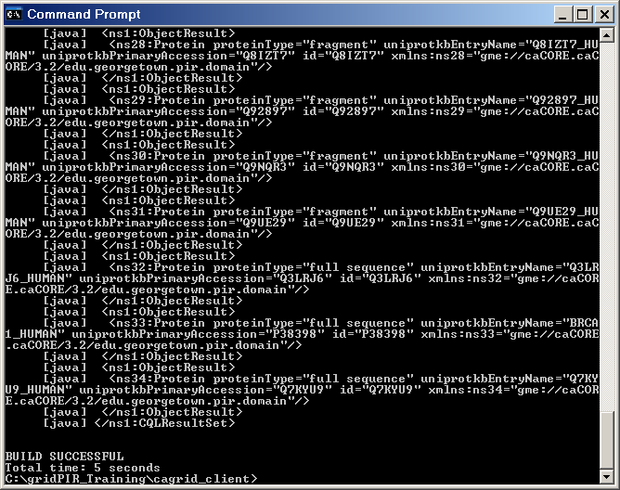
Identify/query the protein corresponding to BRCA1 gene
ant runcaGridSemanticDemo -Dstep=step4
Protein Object with uniprotkbEntryName BRCA1_HUMAN

Slide 78
Collect information on the same protein from different resources
We know
“Protein.uniprotCode” in caBIO is semantically equivalent to “Protein.uniprotkbEntryName” in gridPIR :
“BRCA1_HUMAN” protein from gridPIR corresponds to Human BRCA1 Gene
gridPIR
caBIO
CDE: 2342468v1.0
Notes:
What we know so far?

Slide 79
Collect information on the same protein from different resources
caBIO
Genomic Info
Join caBIO and gridPIRand access to more info
gridPIR
Annotations
Notes:
Use two differently named attributes to “join”/intersect two different models to gather more information.

Slide 80
Collect information on the same protein from different resources
caBIO
<ns1:CQLQuery xmlns:ns1="http://CQL.caBIG/1/gov.nih.nci.cagrid.CQLQuery">
<ns1:Target name="gov.nih.nci.cabio.domain.NucleicAcidSequence">
<ns1:Association name="gov.nih.nci.cabio.domain.Gene" roleName="geneCollection">
<ns1:Association name="gov.nih.nci.cabio.domain.Protein" roleName="proteinCollection">
<ns1:Attribute name="uniProtCode" predicate="EQUAL_TO" value="brca1_human"/>
</ns1:Association>
</ns1:Association>
</ns1:Target>
</ns1:CQLQuery>

Slide 81
Collect information on the same protein from different resources
gridPIR
<ns1:CQLQuery xmlns:ns1="http://CQL.caBIG/1/gov.nih.nci.cagrid.CQLQuery">
<ns1:Target name=“edu.georgetown.pir.domain.ZincFingerRegion">
<ns1:Association name="edu.georgetown.pir.domain.Protein" roleName=“proteinCollection">
<ns1:Attribute name="uniprotkbEntryName" predicate="EQUAL_TO" value="brca1_human"/>
</ns1:Association>
</ns1:Target>
</ns1:CQLQuery>

Slide 82
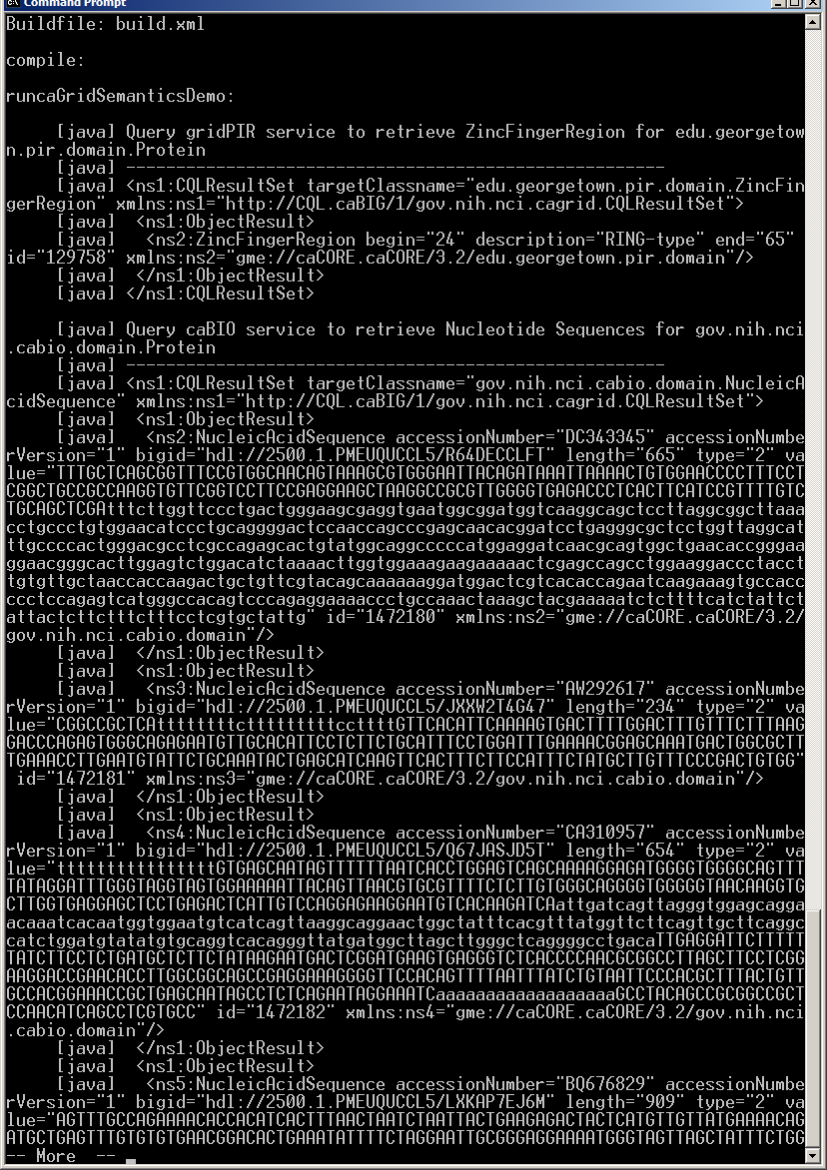
Collect information on the same protein from different resources
ant runcaGridSemanticDemo -Dstep=step5
Zinc Finger Region from gridPIR
Nucleic Acid Sequence from caBIO

Slide 83
Conclusion
Using caBIG™ silver level compatible caGrid Services supported by semantic metadata, one can:
Discover information resources (Standard Vocabularies) – Semantic annotation is important
Query resources using a standard language CQL (Standard APIs) – API/model correspondence is important
Identify ways to combine information from multiple resources (CDEs) – CDE reuse is very important
Notes:
83
See how the guidelines and steps in demo are related.

Slide 84
Backup Slides

Slide 85
SYNTACTIC
SEMANTIC
SEMANTIC
caBIG Compatibility Guidelines
SEMANTIC

Slide 86
The ISO/IEC 11179 Standard
Specifies the kind and quality of metadata necessary to describe data, and it specifies the management and administration of that metadata in a metadata registry (MDR).
Applies to the formulation of data representations, concepts, meanings, and relationships between them, independent of the organization that produces the data.
Does NOT apply to the physical representation of data as bits and bytes at the machine level.
Provides the rules and guidelines for naming and identification of data elements. It defines the identifying attributes, describes the relationship of the attributes to each other and includes principles by which naming conventions can be developed.

Slide 87
ISO Terms and Definitions
Data Element: A unit of data for which the definition, identification, representation and permissible values are specified by means of a set of attributes
Data Element Concept: An idea that can be represented in the form of a data element, described independently of any particular representation
Data Element Representation: The part of a data element having a value domain, data type and other representational specifications
Representation Class: Classification of data elements based on the type of representational form
Conceptual Domain: A set of possible value meanings of a data element expressed without representation
Value Domain: A set of attributes describing representational characteristics of instance data with or without permissible values
Value Meaning: A member of the set of finite allowed inventory of notions that can be categorized for a conceptual domain
Permissible Value: An expression of a value meaning in a specific value domain

